Slide 1
Sentiment Analysis
Objective/What?:
Analysis of Customers’ feedback of a restaurant using Text mining approach called
Natural Language Processing

Slide 2
Why?
Sentiment Analysis is important because companies want their brand being perceived positively, or at least more positively than the brands of competitors.

Slide 3
What is Texting Mining?
The process of deriving meaningful information from natural language text
What is Natural Language Processing?
A component of text mining that performs a special kind of linguistic analysis that essentially helps a machine “read” text.

Slide 4
How it works?
The data we had available was in textual form thus, Unstructured.
First of all, it was needed to be processed and converted into Structured form.

Slide 5
Steps
Step # 1: Import Dataset into Jupyter Notebook
Step # 2: Text Cleaning or Preprocessing
- Removing Punctuations and numbers
- Converting each word into its lower case
- Stemming
Step # 3: Making the bag of words
- Converting textual words into vector(numerical) form for
model input

Slide 6
Step # 4 : Splitting Corpus into Training and Test set.
Step # 5: Fitting a Predictive Model
Step # 6: Predicting Final Results via using .predict()
Step # 7: Measure performance of model using;
- Confusion matrix
- Accuracy score
- Classification Report
Step # 8: Fitting different predictive models and calculate their accuracies.

Slide 7
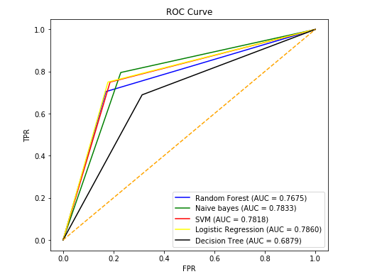
Step # 9: Plotting a ROC curve to exhibit AUC.

